Slide 1
Project 5 - IMDb Movie Analysis

Slide 2
Project Description
In this project we are analysing the dataset which contains information about the movies, their IMDb rating, their budget spent and the earnings they have made, the top 250 movies based on the ratings provided by IMDb, the top directors as per the ratings and also some popular genres and information about the top actors. Before we can proceed to find out any of these results we have to look out for blanks and remove the unnecessary columns from the dataset. The steps taken during cleaning and analysis are further mentioned below in the presentation.

Slide 3
Approach
First we have downloaded the dataset from the link. As the dataset is in the csv format we have used excel to import the contents into a newsheet. We can notice that some cells have the values missing and some columns are unnecessary for our analysis. To identify the the missing values we apply the filter option to all the columns are remove the rows that have blanks values.

Slide 4
Tech-Stack Used
Software used - Ms-Excel 365
The downloaded dataset is given in csv format and we have to use excel 365 to import the contents from the file into a spreadsheet.

Slide 5
Project Excel Sheet Link
https://docs.google.com/spreadsheets/d/1wsIllVCpoMKbOwYL6FFsjMh09QSbr4_B/edit?usp=sharing&ouid=106513403342357132422&rtpof=true&sd=true
This is the link to the excel sheet with the working dataset. Please provide any valuable comments if applicable.

Slide 6
Insights :

Slide 7
Cleaning the data
We remove the columns color, director_facebook_likes, actor_3_facebook_likes, actor_2_name, actor_1_facebook_likes, cast_total_facebook_likes, actor_3_name, facenumber_in_poster, plot_keywords, movie_imdb_link, content_rating, actor_2_facebook_likes, aspect_ratio and movie_facebook_likes.
Also filter the director_name column to find the blank rows and remove them.
Also selected the movie_name column and used the remove duplicates option

Slide 8
Movies with highest profit
We have added a new column named “profit” calculated as the difference of budget from the gross column.
Then the “profit” column is sorted in descending order
To observe the outliers we have used the XY(scatter) chart with the budget in the x axis and the profit in the y axis.

Slide 9
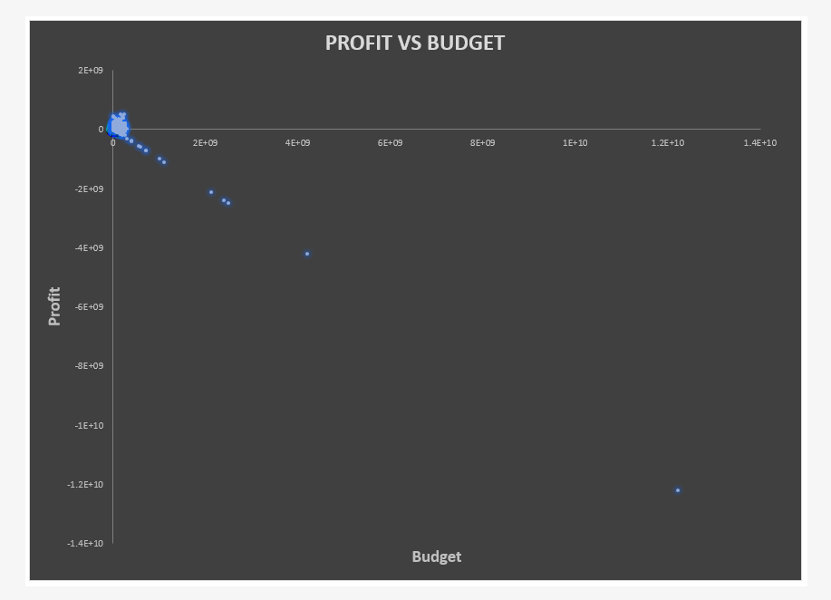
Profit Vs Budget plot with outliers

Slide 10
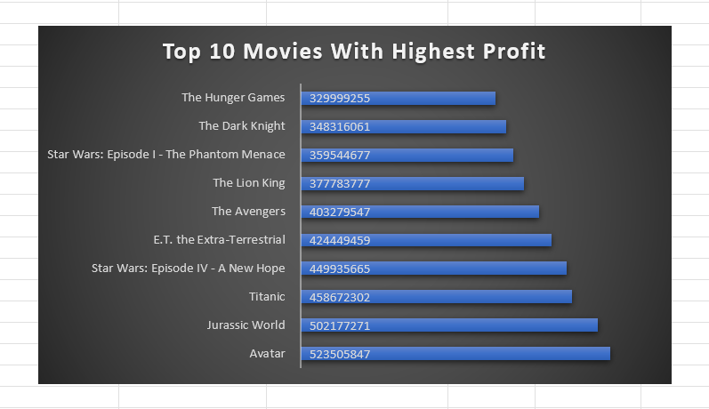
Top 10 Movies With Highest Profit

Slide 11
Top 250 Rated Movies
First filter the column num_voted_users by selecting the number filters which are greater than 25000
Then create a column named Rank
Use the formula - RANK(N3,[imdb_score]) to assign ranks to the movies based on their respective imdb_score
Then we have filtered out the English from the language column to get the top foreign language films based on their imdb rating

Slide 12
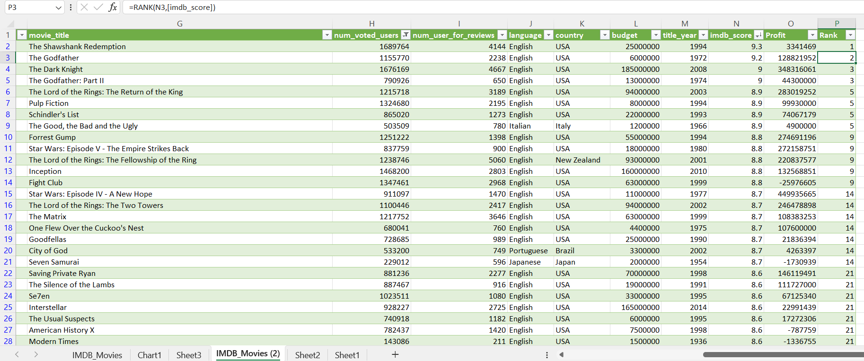
Top 250 Rated Movies

Slide 13
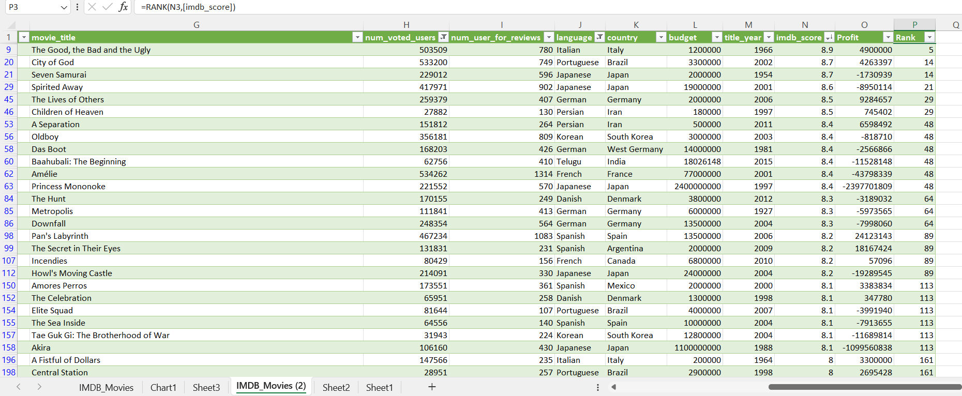
Top Foreign Language Films

Slide 14
Best Directors
Insert a pivot table and add the director_name column as rows and mean of imdb score into the values area
Then filter the director name by selecting value filters and top 10 based on the mean of imdb_score.

Slide 15
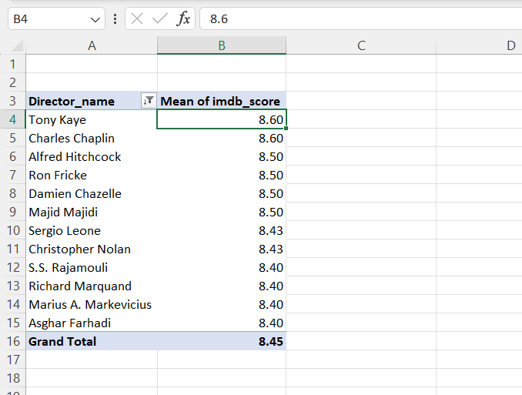
Top 10 Directors

Slide 16
Popular Genres
We have inserted a pivot table to know about the top 10 popular genres
In the pivot table genres is used as row axis and the count of the genres as the values
Then using the filter we have shown the top 10 genres based on their count in descending order
Also uses a clustered column chart to represent the same

Slide 17
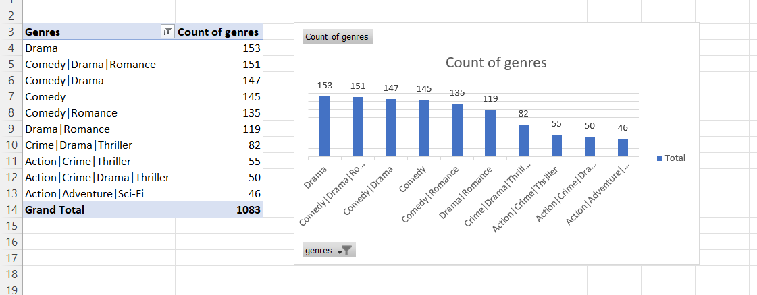
Popular Genres

Slide 18
Critic & User reviews Comparison
Used pivot table to filter out the actors Brad Pitt, Leonardo DiCaprio and Meryl Streep
Calculate the mean of the user reviews and critic reviews for each of them separately
We observe that for both the user and critic reviews, actor Leonardo DiCaprio has the highest mean.

Slide 19
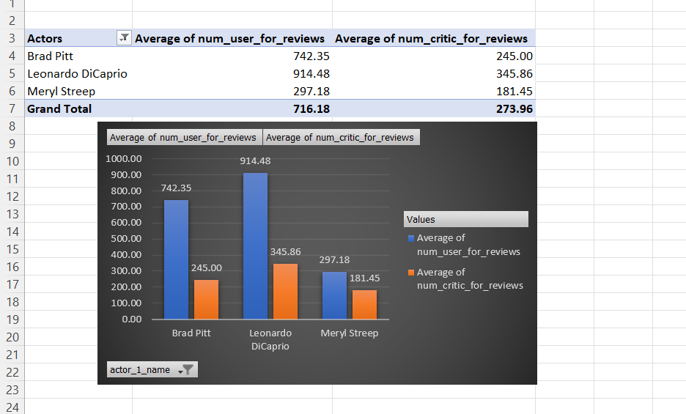
Critic and User Reviews Comparison

Slide 20
Change in No of voted users over decades
Create a pivot table and assign title year as row labels.
Then we have used the group field option and set the starting date as 1920 and ending date as 2016 and set the difference as 10
Then add the sum of num_voted_users column as values
Then used a bar chart to plot the same

Slide 21
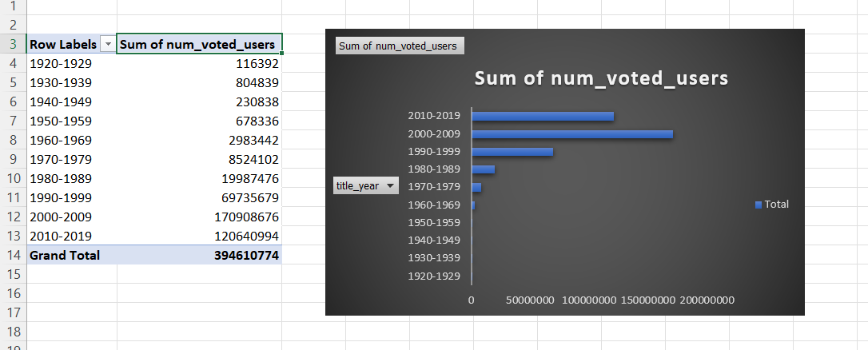
Change in No of voted users over decades

Slide 22
Result
While doing the project I learned how to use the pivot table and filter, order & group the data using the pivot table. Also learned about the different types of charts and which one will be applicable for what types of analysis. I learned how to clean the data before analysis and answered questions like which movies made the highest profit, movies that were highly rated, foreign language films that are highly rated, who are the top directors, found out the popular genres, compared between 3 actors and the critic reviews they got and also how the number of voters have changed over the decade.

